Slide 1


WEB DEVELOPMENT OVERVIEW

Slide 2
About HTML 5
Hypertext Markup Language was introduced in 1990.
HTML 5 was recommended as a standard by W3C in 1997.
HTML 5 is the next version and will be the new standard.
Majority of the browsers support HTML 5 element and Application Programming Interface (API).

Slide 3
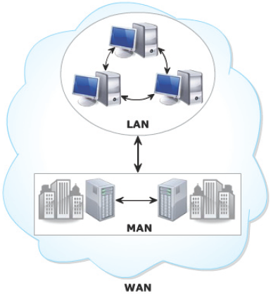
Types of Networks
^{Local Area Network (LAN)}
Metropolitan Area Network (MAN)
^{Wide Area Network (WAN)}
Network in a small geographical area
Network that covers city
Network that connects LANs and MANs across the globe

Slide 4
What is Internet ?
Internet is network of networks
Internet is known as the largest WAN.
WAN raised the need to share data across the globe rather than within an organization.
This resulted in the evolution of Web also known as World Wide Web (WWW).

Slide 5
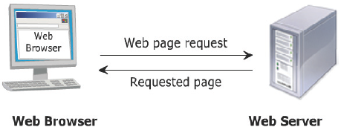
Web Communication
Steps to view a Web page in a browser are as follows:
1. User specifies the Uniform Resource Locator (URL) of Web page in a browser.
2. The client browser sends the URL request to the appropriate Web server.
3. Web server processes the request and sends the Web page as a response to the browser.

Slide 6
Why Web designing is Important?
1. It sets the first impression
2. It aids your search engine optimization (SEO) strategy
3. It sets the impression for customer service
4. It builds trust with your audience
5. Your competitors are doing it

Slide 7
Your website should be designed keeping in mind your audience and should ensure that it improves user experience.
Brand image
Colour
Layout
Fonts and typography
Website accessibility
Site navigation
What is Website?
A collection of web pages which are grouped together and usually connected together in various ways. Often called a "web site" or a "site."
What is Webpage?
A document which can be displayed in a web browser such as Firefox, Google Chrome, Opera, Microsoft Internet Explorer or Edge, or Apple's Safari. These are also often called just "pages."
What is Web server?
It is an Storage Area , where out files are stored

Slide 8
Types of Web Pages
Web Page
Static Web Page
Dynamic Web Page

Slide 9
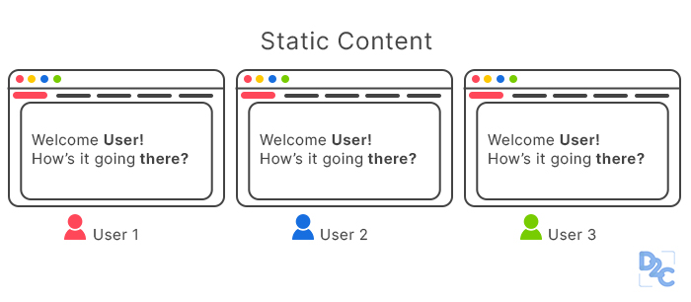
Contents remain unchanged
Static Web Pages
Consists of content such as text, images, videos and so on
Focuses on content presentation
Simple to design as it provides no interactivity

Slide 10
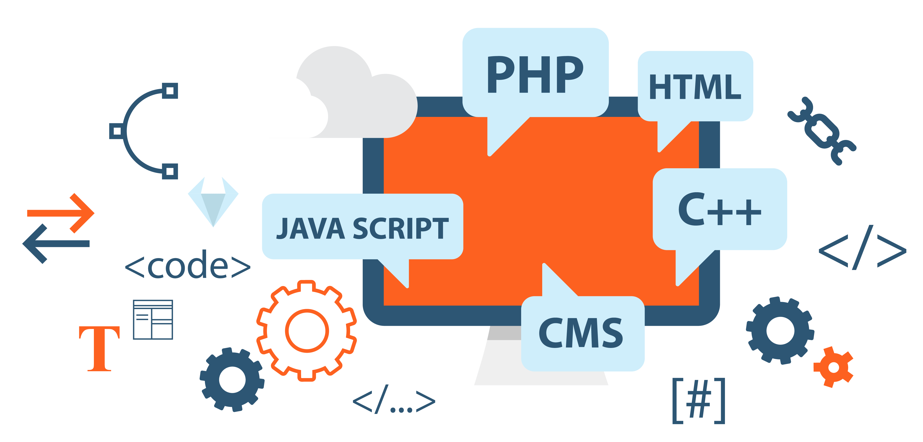
Allows customization of content and its appearance in browser
Dynamic Web Pages
Data is always up-to-date and reliable
Generates content on-demand when user provides input
Allows user interaction

Slide 11
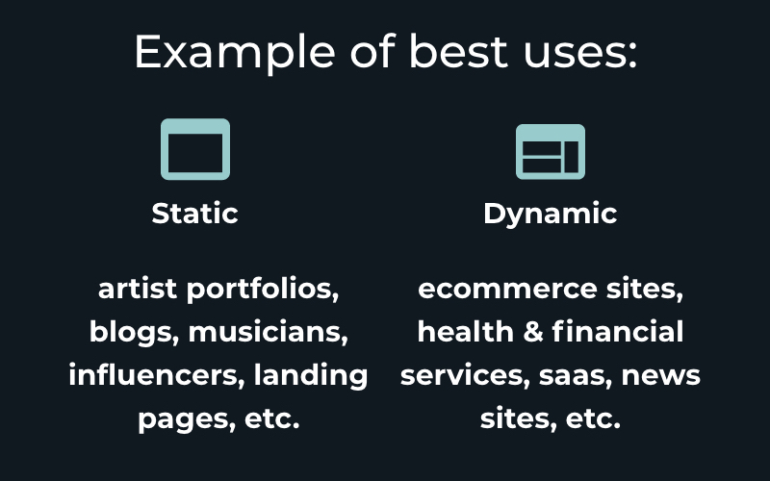

Slide 12
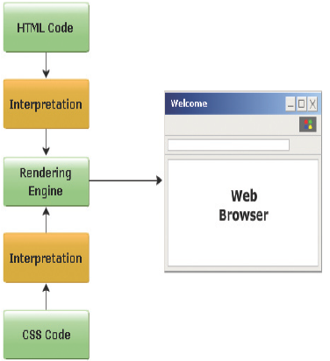
HOW HTML Code Works?

Slide 13
Web Development Career Options
Front-end developer
Full-stack engineer
Back-end developer
Software engineer
Senior web developer
Skills of a Successful Developer
Attention to detail
Logical thinking
Creativity

Slide 14
